Slide 1
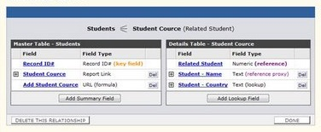



Creating Data-Driven ASP.NET Web Applications
Svetlin Nakov
Telerik Corporation
www.telerik.com

Slide 2

Table of Contents
ASP.NET Data Sources
SqlDataSource
EntityDataSource
ObjectDataSource
Using ASP.NET Data Sources
Editable List Controls
Master-Detail Navigation
Implementing Data-Driven Web Applications with GridView, FormView, DetailsView, …
Notes:
Бележки на автора:
Съдържание - Контроли

Slide 3
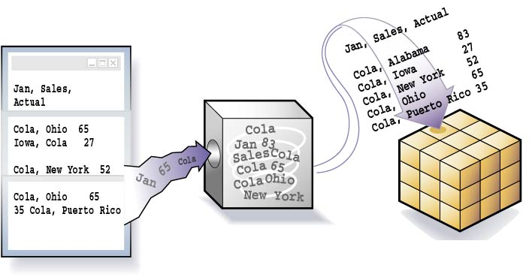

ASP.NET Data Sources

Slide 4
ASP.NET Data Source Controls
ASP.NET provides server controls that take care of data binding details
Known as data source controls
ObjectDataSource, SqlDataSource, XmlDataSource, EntityDataSource, …
They are an abstraction over the data source
Data-bound server controls can be associated to a data source control
Through the DataSourceID property

Slide 5
SqlDataSource
EntityDataSource provides connection to a relational DB (MS SQL Server, Oracle, …)
Data is manipulated by using commands
Select, Update, Insert and Delete
Commands can be either SQL queries or names of a stored procedures
Data is processed with a DataSet (by default)
The DataSourceMode property specifies whether to use DataSet or DataReader

Slide 6
SqlDataSource – Example
<asp:GridView ID="GridViewCustomers" runat="server"
DataSourceID="SqlDataSourceNorthwind">
</asp:GridView>
<asp:SqlDataSource ID="SqlDataSourceNorthwind"
runat="server" ConnectionString=
"<%$ ConnectionStrings:NorthwindConnectionString %>"
SelectCommand="SELECT [CompanyName], [ContactName],
[PostalCode], [Phone], [Address] FROM [Customers]">
</asp:SqlDataSource>
Note that your SQL is the presentation layer
Mixing presentation and database logic is very bad practice, so use SqlDataSource!

Slide 7



Using SqlDataSource
Live Demo

Slide 8
LinqDataSource
The EntityDataSource is designed to bind against a LINQ-enabled data model
The control gives you a way to connect a data control to a wide variety of data sources
Database data (e.g. Entity to SQL query)
Data-source classes
In-memory data collection
You can connect the EntityDataSource to any kind of data collection that is stored in a public field or property

Slide 9

LinqDataSource (2)
Benefits
It leverages the flexibility that LINQ based ORMs provide
The EntityDataSource automatically creates the commands for interacting with the data
LINQ enabled data sources
<book>
<title/>
<author/>
<price/>
</book>
Objects
Relational Data
XML

Slide 10
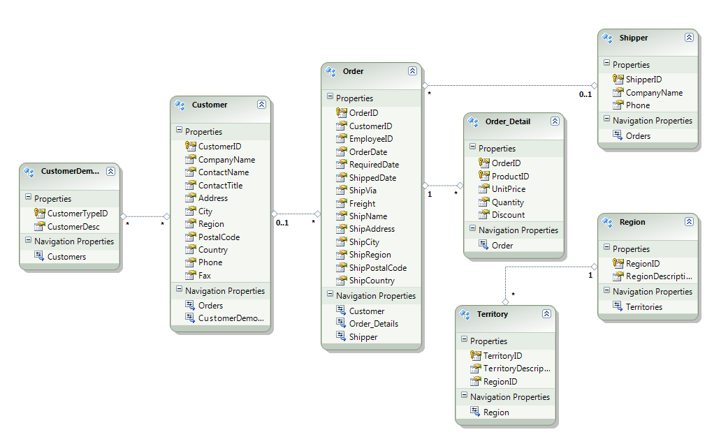
LinqDataSource – Example
Define the data model (e.g. Entity to SQL mappings)
Create a basic product listing (e.g. GridView)
<asp:GridView ID="GridViewProducts" runat="server">
</asp:GridView>
Notes:
ObjectDataSource..::.TypeName Property
Gets or sets the name of the class that the ObjectDataSource object represents.
ObjectDataSource..::.DataObjectTypeName Property
Gets or sets the name of a class that the ObjectDataSource control uses for a parameter in an update, insert, or delete data operation, instead of passing individual values from the data-bound control.

Slide 11
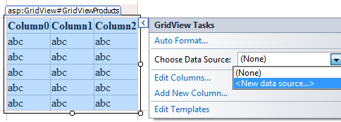
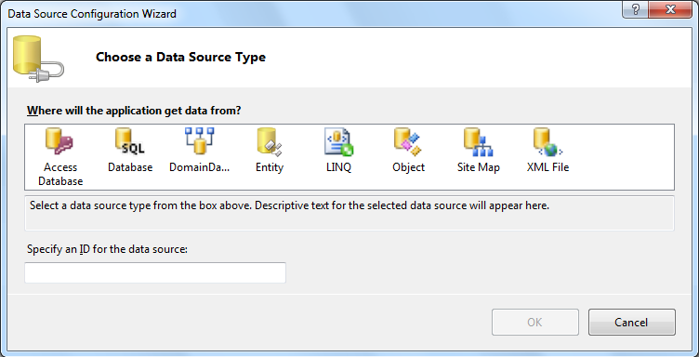
LinqDataSource – Example (2)
Bind the GridView to the data model
Select the new "Entity" option in the dialog box
Notes:
ObjectDataSource..::.TypeName Property
Gets or sets the name of the class that the ObjectDataSource object represents.
ObjectDataSource..::.DataObjectTypeName Property
Gets or sets the name of a class that the ObjectDataSource control uses for a parameter in an update, insert, or delete data operation, instead of passing individual values from the data-bound control.

Slide 12
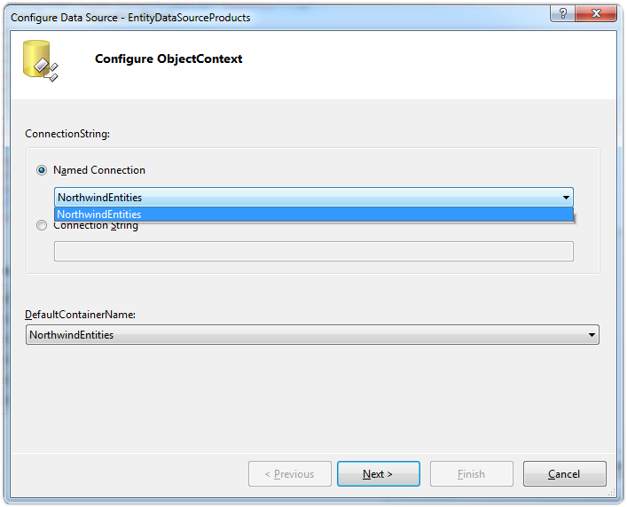
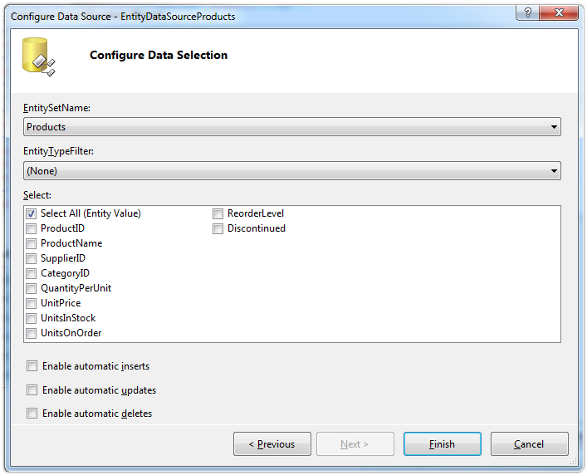
LinqDataSource – Example (3)
Designer will then display the available Entity to SQL ObjectContext classes
Choose the table and click [Finish]
Notes:
ObjectDataSource..::.TypeName Property
Gets or sets the name of the class that the ObjectDataSource object represents.
ObjectDataSource..::.DataObjectTypeName Property
Gets or sets the name of a class that the ObjectDataSource control uses for a parameter in an update, insert, or delete data operation, instead of passing individual values from the data-bound control.

Slide 13
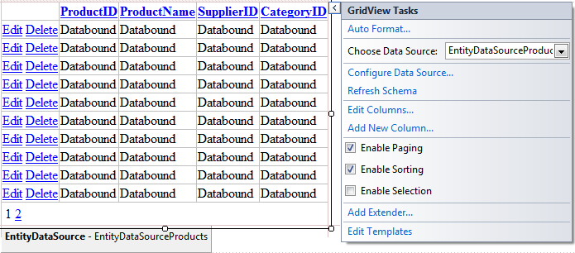
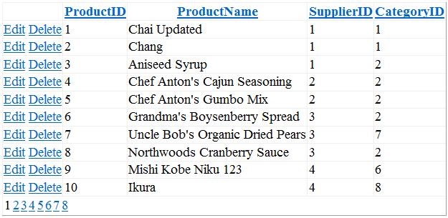
LinqDataSource – Example (4)
The result (in Visual Studio)
The result in the Web browser
Notes:
ObjectDataSource..::.TypeName Property
Gets or sets the name of the class that the ObjectDataSource object represents.
ObjectDataSource..::.DataObjectTypeName Property
Gets or sets the name of a class that the ObjectDataSource control uses for a parameter in an update, insert, or delete data operation, instead of passing individual values from the data-bound control.

Slide 14
LinqDataSource – Example (5)
<asp:GridView ID="GridViewProducts" runat="server"
DataSourceID="EntityDataSourceProducts"
DataKeyNames="ProductID"
AllowPaging="True" AllowSorting="True">
<Columns>
<asp:CommandField ShowDeleteButton="True"
ShowEditButton="True" />
</Columns>
</asp:GridView>
<asp:EntityDataSource ID="EntityDataSourceProducts"
runat="server" ConnectionString="name=NorthwindEntities"
DefaultContainerName="NorthwindEntities"
EntitySetName="Products">
</asp:EntityDataSource>

Slide 15
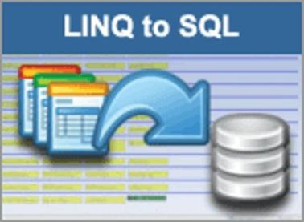


Using EntityDataSource
Live Demo

Slide 16
ObjectDataSource
ObjectDataSource enables data-binding of UI control to an object
Instead of directly binding to a database
Needs a middle-tier business object
Data manipulation is based on methods
TypeName – name of the business object
DataObjectTypeName – a class holding the Select, Update, Insert, Delete methods
SelectMehtod, UpdateMethod, …
Notes:
ObjectDataSource..::.TypeName Property
Gets or sets the name of the class that the ObjectDataSource object represents.
ObjectDataSource..::.DataObjectTypeName Property
Gets or sets the name of a class that the ObjectDataSource control uses for a parameter in an update, insert, or delete data operation, instead of passing individual values from the data-bound control.

Slide 17
ObjectDataSource – Example
<asp:ObjectDataSource ID="dsProducts"
runat="server" TypeName="ObjectDataSourceProducts"
DataObjectTypeName="Product"
SelectMethod="GetAll" InsertMethod="Insert"
UpdateMethod="Update" DeleteMethod="Delete">
</asp:ObjectDataSource>
<asp:GridView ID="GridViewProducts" runat="server"
DataSourceID="dsProducts" DataKeyNames="ProductID">
</asp:GridView>

Slide 18



Using ObjectDataSource
Live Demo

Slide 19
Other Data Sources
Hierarchical
XmlDataSource
Establishes a connection to an XML source of data (files, documents)
DataFile, TranformFile, XPath
SiteMapDataSource
MS Access
AccessDataSource
Derives from SqlDataSource
DataFile

Slide 20
ObjectDataSource with Entities-to-SQL, ListView and FormView
Define the data model (Entities to SQL)
Add new class Categories
Add method GetAllCategories in the Categories class
public static DataClassesObjectContext objectContext =
new DataClassesObjectContext();
public static IQueryable<Category> GetAllCategories()
{
var categories =
from category in dataContext.Categories
orderby category.CategoryName select category;
return categories;
}

Slide 21
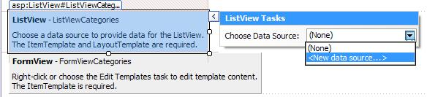
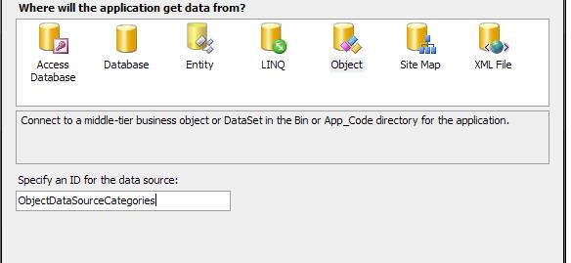
ObjectDataSource with LINQ-to-SQL, ListView and FormView (2)
Add ListView and FormView controls to the aspx page
Bind the ListView to the ObjectDataSource

Slide 22
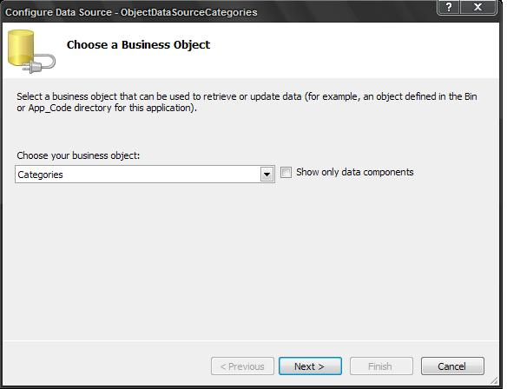
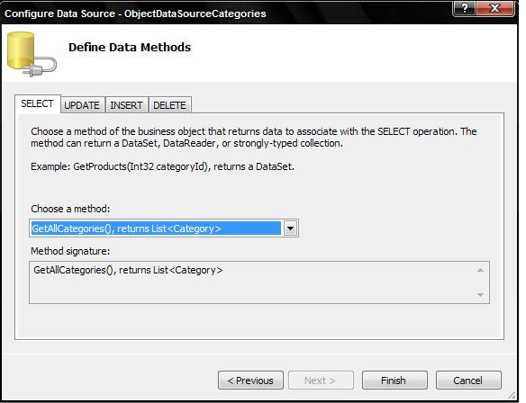
ObjectDataSource with LINQ-to-SQL, ListView and FormView (3)
Next choose your custom class Categories
And choose method GetAllCategories

Slide 23
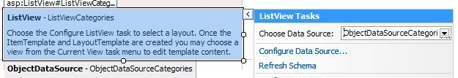
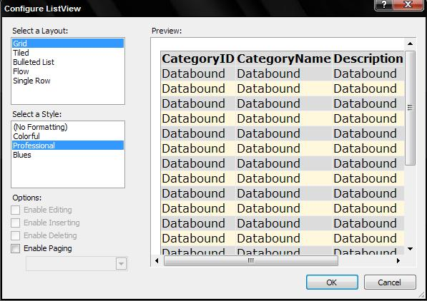
ObjectDataSource with LINQ-to-SQL, ListView and FormView (4)
Click to configure the ListView control
Optionally choose layout and style

Slide 24
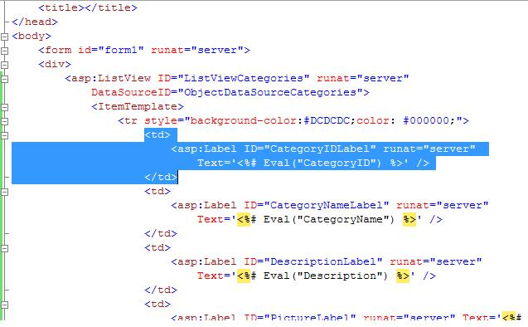
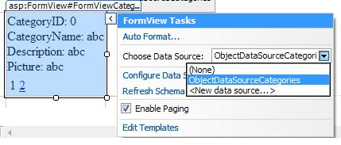
ObjectDataSource with LINQ-to-SQL, ListView and FormView (5)
Delete from all templates the row which represent pictures
Bind the FormView to ObjectDataSource and enable paging

Slide 25
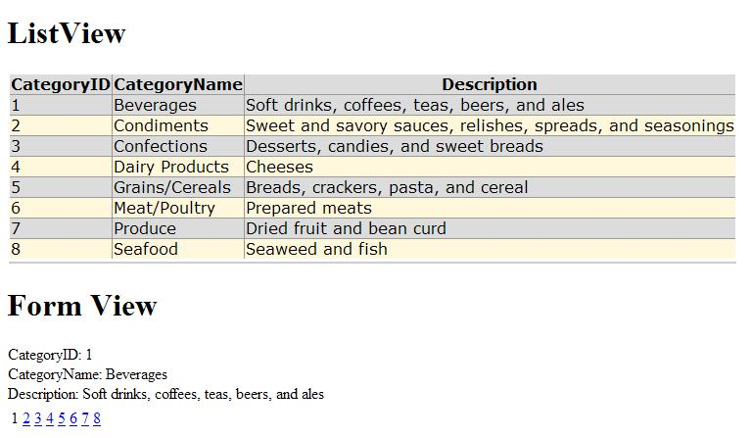
ObjectDataSource with LINQ-to-SQL, ListView and FormView (6)
The result is:

Slide 26

Creating Data-Driven ASP.NET Web Applications
Questions?

Slide 27
Exercises
Create a Web form that contains a GridView control. Bind it to the Categories table from the Northwind database using LinqDataSource and LINQ to SQL data context classes. Implement selection, editing and deleting of rows. Enable sorting and paging.
Implement inserting of new categories by adding a FormView control bound to the same data source.
Reimplement the same functionality with ObjectDataSource.

Slide 28
Exercises (2)
Using LinqDataSource, ASP.NET data-bound controls and LINQ to SQL create a Web application to display information about towns and countries stored in SQL Server database. Each country has name, language, national flag and list of towns. Each town has name, population and country. Use a set of text boxes to show a single country in the left side of the main form along with navigation buttons (Next / Previous) to change the currently selected country. Use GridView on the right side of the form for the towns of the currently selected country. When the current country changes, load and display its towns.

Slide 29
Exercises (3)
Add to the system a new information object: continents. Countries are considered to reside in exactly one of the continents. Use ListBox to display the continents. Implement master-detail navigation: when a continent is selected, its corresponding countries are loaded. When a country is selected, its towns should be loaded.
Implement editing of all information objects in the system (add / edit / delete). Implement adding as a separate .aspx page.

